Slide 1
Data Augmentation in LU
Presenter: Haoda Chu
Collaborators:
Subhabrata Mukherjee, Minwoo Jeong, Ming Wu, Ahmed Awadallah

Slide 2
Scope
Language understanding for English
Why use data augmentation in LU?
New scenarios with no user-specific tenant data
NL teams message search, 3rd party LU
Well-defined scenarios with abundant user traffic
Compliant boundary, Schema change
TVS
Complementary to pre-trained LM
Notes:
In this presentation, We are particular interested in two scenarios that can benefit form data augmentation
For the first scnearo, lets say we are shipping a new feature. New scenarios when we don’t have user-specific tenant data, such as teams message and third part LU
Old scenarios when we have a lot of unlabeled data available, but due to the compliance reasonses, we cannot directly annotate these user query
On the other hand, the large amount of annotated data are no longer very helpful due to the
One may ask the question why should we investigate on given the promising results in low resourcing LU via using pre-trained LM
Mention the improvement of model did alleviate the low resource issue, but data augmentation is also complementary to pre-trained LM

Slide 3
Technical Questions
How to build a robust model for new LU scenarios?
Back translation + consistency learning
How can LU Model benefit from task-specific unlabeled data for well-defined LU scenarios
Pretrained LM + Self-training

Slide 4
Technical Questions
How to build a robust model for new LU scenarios?
Back translation + Consistency Learning
How can LU Model benefit from task-specific unlabeled data for well-defined LU scenarios
Pretrained LM + Self-training

Slide 5
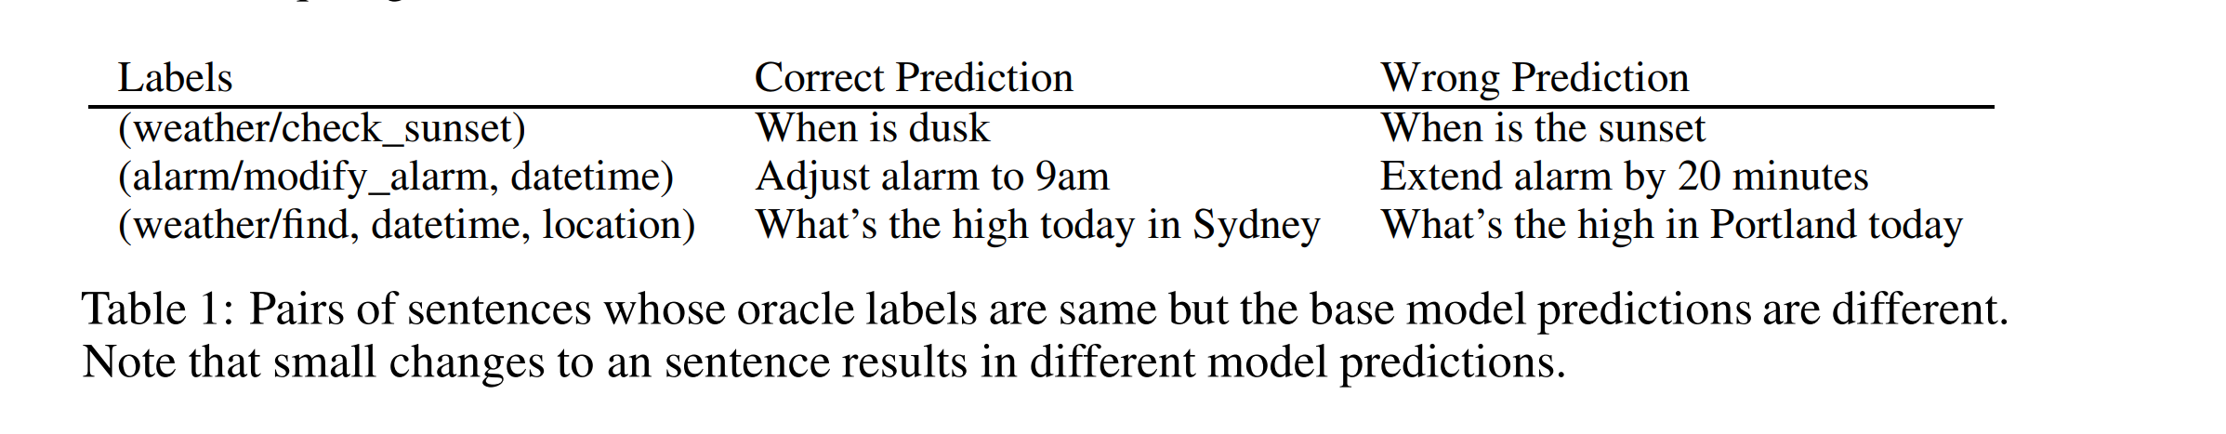
Build a robust LU model for new scenarios
Challenges
Limited task specific labeled data L
No additional user-tenant data U
Data augmentation in LU
Often used as supervised data
External resource: lexicons, query patterns
Cons: Noisy label; Alter the meaning of query
Notes:
The lack of training data posing a lot challenges for building robust LU model for new features.
Data augmentation has already been explored in LU for a while. Typically, what we do in LU is to generate some synthetic training data based on lexicon and query patterns. This approach has been its effectiveness in the past model iteration.
Due to the noise in the lexicons and query patterns, These methods have the risk of generating noisy training label and may completely change the meaning of original querty
directly pass these training data for the LU model will make more sensitivive to the input noise.
Especially for sloting
Slot tagging is arguably harder compared to intent classification since the spans need to align as well.
For instance, intent are same but, slots

Slide 6
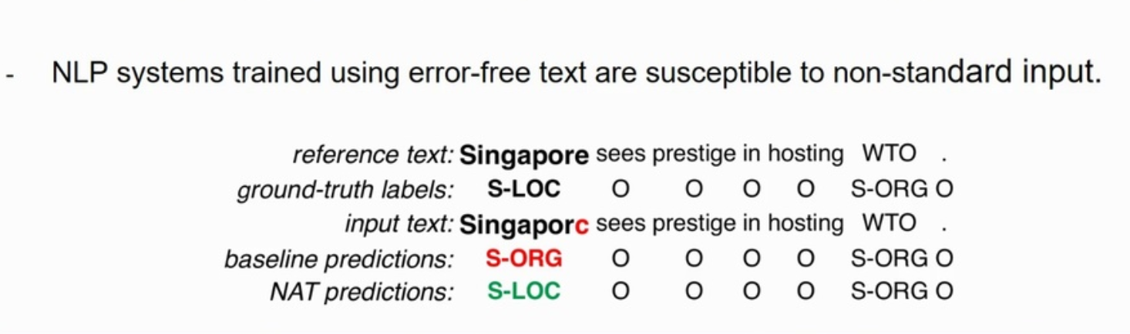
Examples of noisy data augmentation
Notes:
For instance,
Slot
intent
May need to add some promising data augmentations
Data augmentation often introduce additional noise
We may able to find another examples from facebook’s robustness paper
https://arxiv.org/pdf/1911.05153.pdf

Slide 7
Build a robust LU model for new scenarios
Challenges
Limited task specific labeled data L
No additional user-tenant data U
Data augmentation in LU
Often used as supervised data
External resource: lexicons, query patterns
Recent Literature
Consistency learning / Adversarial training/ Noise-aware of training
Cons: Noisy label; Data bias/data imbalanced issues
Notes:
So how can we have a robust LU model?
To tackle this issue, a widely adopted solution is to employ consistency learning, noise aware of training and Adversarial training after data augmentation step.
The main idea is to explicitly modeing this noise in training step via adding some constrain, These approches enforces the model to be insensitive to the noise and hence smoother with respect to changes in the input (or hidden) space
For this presentation, we mainly explore the effectiveness of Consistency learning in
The exploration of other two approaches are left for future work

Slide 8
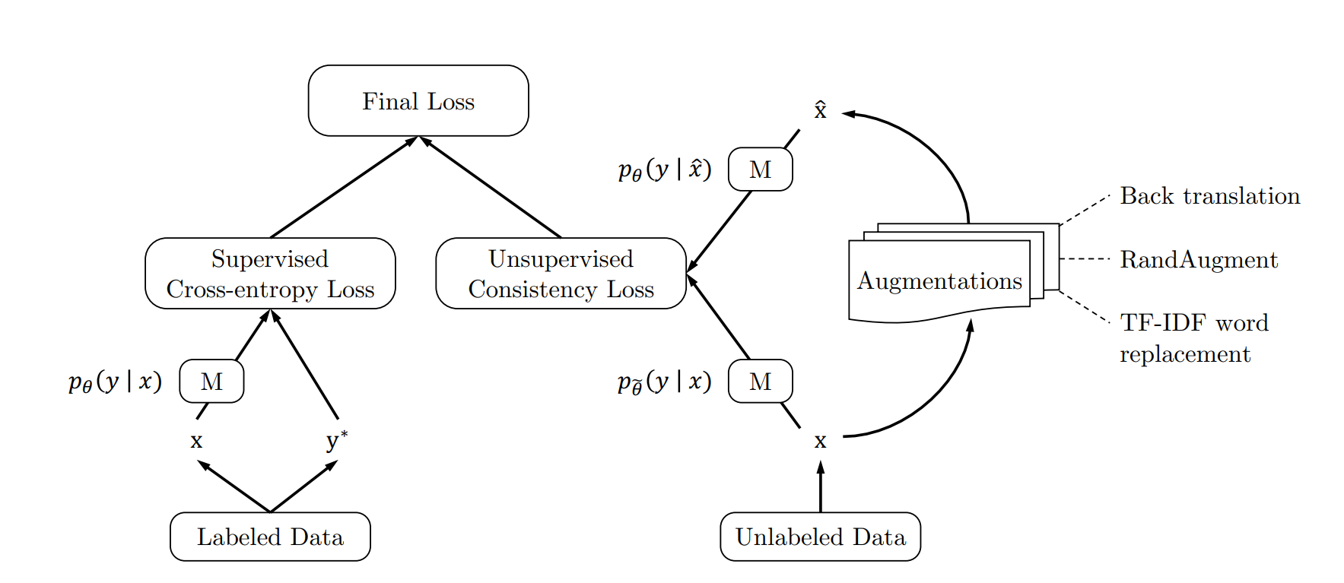
Unsupervised Data Augmentation (UDA) with Consistency Learning
Source: Xie, Qizhe, et al. "Unsupervised data augmentation for consistency training." arXiv preprint arXiv:1904.12848 (2019).
Notes:
Let’s first introduce the formulation of consistent learning in text classification and computer vision. The typical procedure of consistency learning is summarized . Given an input x, we compute the output distribution p(y|x)), by injecting a small noise to (either input and output). We then minimize a divergence metric between the original output and noised-corrupted output. Miminizing the consistency loss can make model smoother to some local changes to the input( or hidden space)
Recent work done by google research show that some of the sota data augmentation approach can be serve as a superior source of noise under the consistency enforcining semi-supervised framework. They consider data augmentation to be the noise transformation and apply it to the unlabeled data.
To use labeled data, it computes the loss function using standard methods for supervised learning to train the model, as shown in the left part of the graph below.
For unlabeled data, consistency training is applied to enforce the predictions to be similar for an unlabeled example and the augmented unlabeled example, as shown in the right part of the graph.
For text classification, they apply back translation and TF-IDF word replacement. For
It is also worth to mention that previous data augmentation is often limited to supervised learning only, in which labels are required to transfer from original examples to augmented ones. Which means UDA can be applied when abundant unlabeled data is available
https://www.fast.ai/2020/01/13/self_supervised/
https://ai.googleblog.com/2019/07/advancing-semi-supervised-learning-with.html

Slide 9
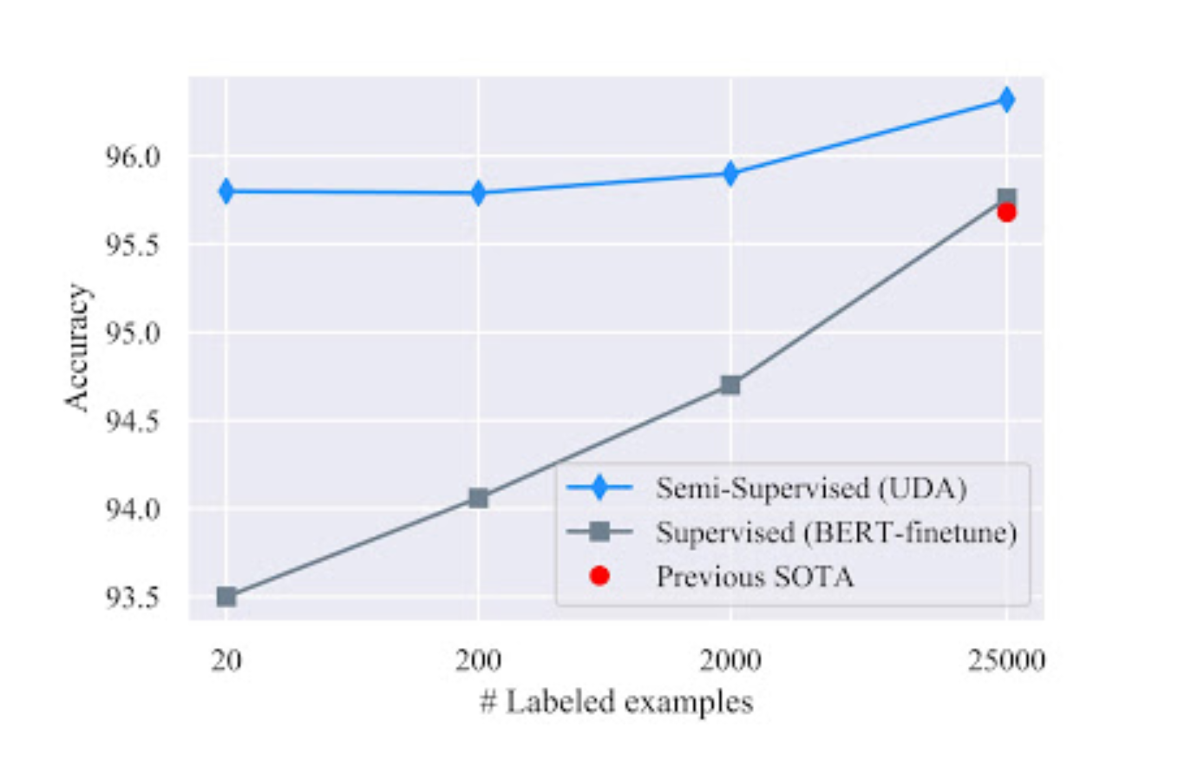
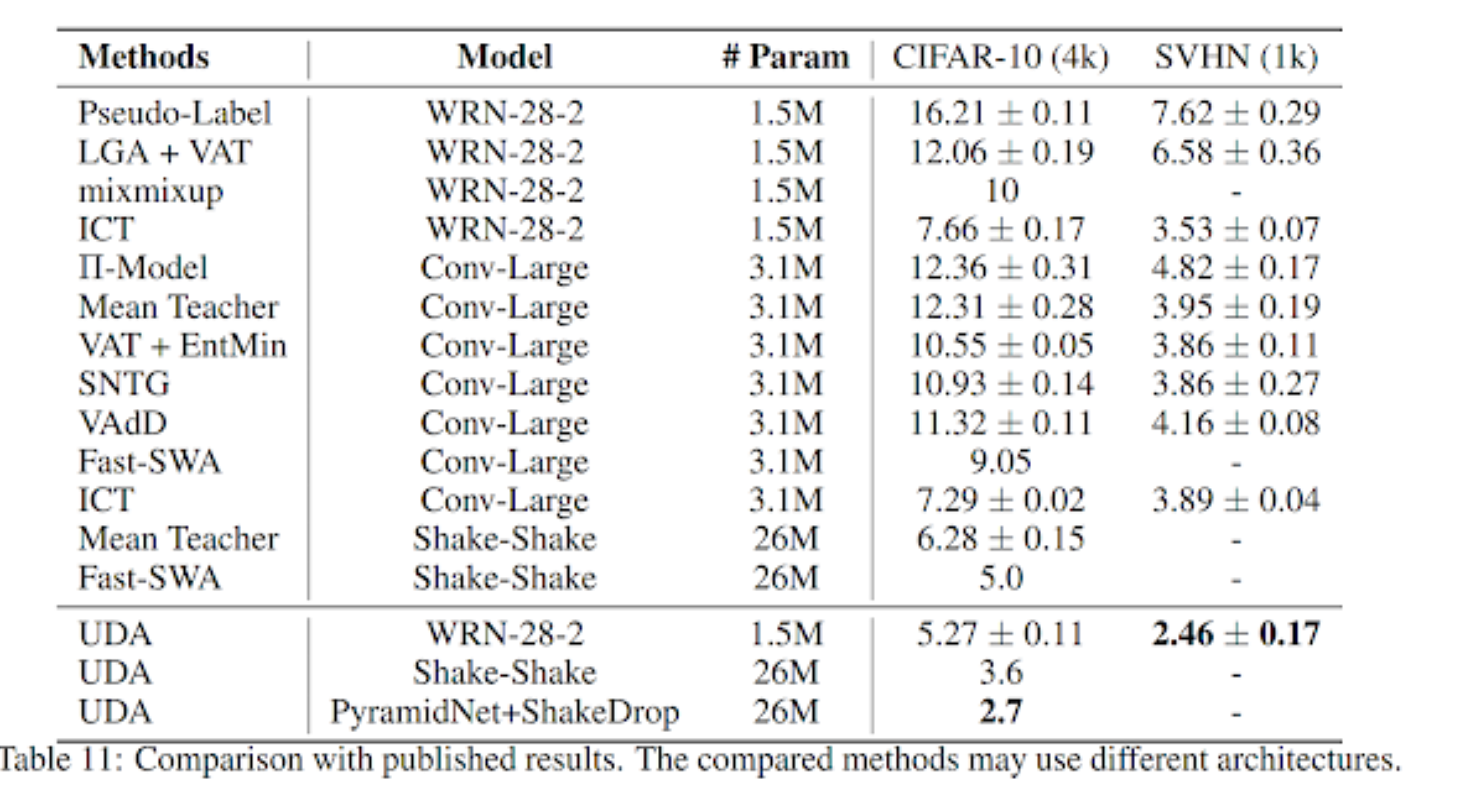
UDA in NLP and CV
IMDB sentiment analysis Task
Image Classification Task
Notes:
Via using data augmentation + consistency learning, UDA is surprisingly effective in the low-data regime. With only 20 labeled examples, UDA achieves an error rate of 4.20 on the IMDb sentiment analysis task by leveraging 50,000 unlabeled examples (along with the data augmentation). This result outperforms the previous state-of-the-art model trained on 25,000 labeled examples with an error rate of 4.32.
In the large-data regime, with the full training set, UDA also provides robust gains.

Slide 10
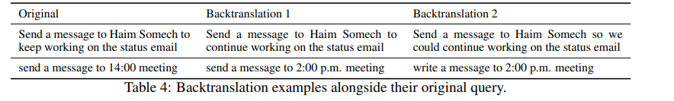
Consistency learning for slot tagging
Back translation for slot tagging
Translate query in English to French and then backtranslating to English for generating paraphrases
The generated query are then used as unlabeled data to get consistency loss
Challenges:
Slots in the original source sentence may no longer be aligned to those in the corresponding (paraphrased) backtranslations
Different sequence lengths of the original and back translated sequence.
Assumptions:
Contextualized representations for overlapping concepts should be similar in the original and its perturbed sequence under the small noise assumption.
Notes:
Having seen the success of UDA in text classficiation and CV, we would like to employ it in our scenarios. And the specific data augmentation approach we used is back translation
Non-trival to extemd to slot tagging, While prior work applies consistent learning additional complexities as (i) the slots in the original source sentence may no longer be aligned to those in the corresponding (paraphrased) backtranslation with (ii) different sequence lengths of the original and backtranslated sequence.
For instance, give two examples
To this end, we explore the following hypothesis that is invariant to token position and sequence length:
We select overlapping concepts via aligmment,
Via selecting overlapping concepts we are hoping the model can be robust to whatever said inside the slot, its kind of like enforing model to learning from the context of slots, which is similar to what we did in FST.

Slide 11
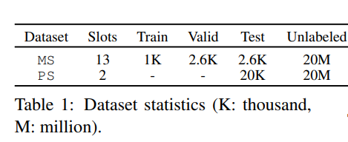
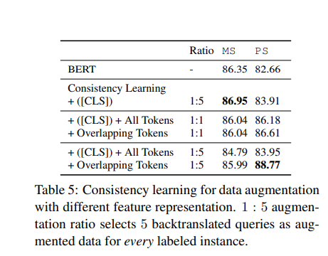
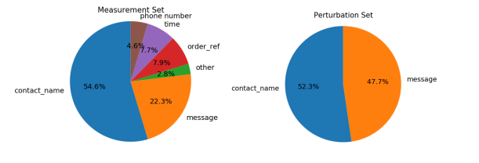
Experiment Results
Experiment settings:
Labeled training data from TVS
Unlabeled training data : Augmented from labeled data via back translation
Notes:
Evaluate
The first set of utterances (referred as MS) is sampled from tvs traffic and manually annotated with slot labels.
To evaluate the robustness of our model for dominant slots, we create another test set (referred as PS) by perturbing the previous test data.
.We consider the following models and variations for analysis: (1) BERT fine-tuned on small amount of labeled data (2) Prior work on consistency learning leveraging backtranslation (UDA (Xie et al., 2019)) with BERT as the encoder. UDA learns model parameters to minimize the representation loss between the source query and the backtranslated one as given by corresponding representations of the [CLS] token. (3) In this, we extend the prior model to optimize for the overall representation loss from the [CLS] token as well as from all other tokens in the query jointly. (4) In this variation, we consider only the overlapping tokens in the original and backtranslated query, and minimize the representation loss for the corresponding tokens along with the [CLS] representation loss for optimizing Equation
Table 5 shows the results of consistency learning with different loss functions and augmentation ratio. We observe the token-wise representation loss over all tokens to significantly improve the base model on the perturbation set. This indicates the importance of considering alignment of the tokens in the original and backtranslated query for consistency learning. We also observe the model performance to improve with increasing the amount of backtranslated data with higher augmentation ratio

Slide 12
Technical Questions
How to build a robust model for new LU scenarios?
Back translation + consistency learning
How can LU Model benefit from task-specific unlabeled data for well-defined LU scenarios
Pretrained LM + Self-training
Notes:
Let’s switch our attention to the second scenarios where we have abundant unlabeled data available

Slide 13
Pesudo label generation via self-training
Challenges:
Task-specific labeled data L
Task-specific Unlabeled data: U
L << U
Approaches:
Unsupervised Mask Language loss for (continual)pre-training
Pesudo-label generation via self-training
Notes:
In this contrast to the previous scenario, we have huge amounts of data, we have access restrictions to this data due to privacy concerns primarily related to user data. As such, we cannot collect any human annotations for this data.
To effectively utilize those task-specific unlabeled data, we propose a two stage data augmentation
First we do continual pre-training in language model using these unlabeled data (instead of training from scratch), In the first step training we do Lm Pre-training to make sure the model is aware of the domain-specific vocabularay
Then, we do pseudo label generation via self-training over those unlabeled data
I will ship the intro of pre-training

Slide 14
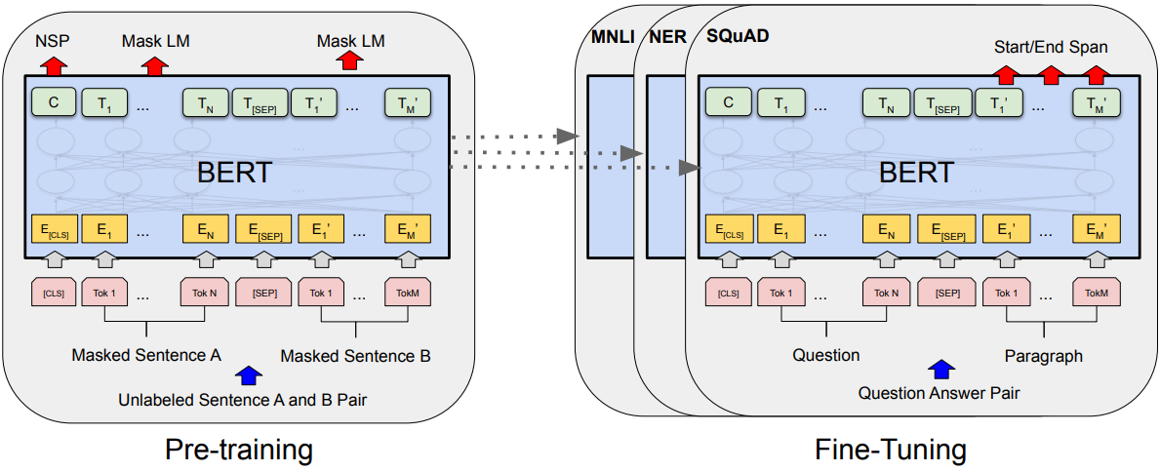
Pre-trained LM
On Large General Text Corpus
On small Task Domain Corpus
Source: https://arxiv.org/abs/1810.04805
Notes:
Following the standard settings in BERT, we do two stage
Pre-trained LMs are generally applied into many NLP tasks and significantly improve the task performance. BERT is one of the representative work, here we use it as an example to introduce the general flow of pre-trained LMs.
Unsupervised loss to pre-trained BERT on a very large general text corpus, here unsupervised loss used in the bert is next sentence predication and mask language loss.
After pretraining is finish, we will fine-tune the pre-trained model with specific task loss.

Slide 15
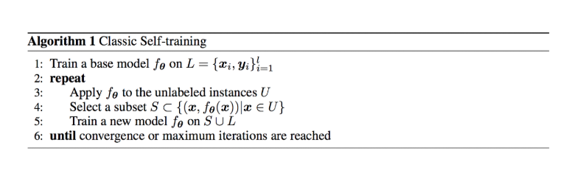
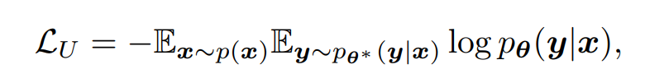
Self-training
The main idea is to find a way to augment the labeled dataset with the unlabeled dataset.
Recent literature suggest that it works well for deep learning model in low/high resource setting.
Dependency parsing, Machine Translation, and Image Classification
Notes:
Let me first give a quick intro of self-training
As one of the earliest SSL approaches self-training has recently been shown to obtain state of-the-art performance for tasks like neural machine translation (He et al., 2019), Dependency Parsing and Image Classificaiton
performing at par with supervised systems when they have large amounts unlabeled data avaible
As shown in Algorithm 1, classic self-training starts from a base model trained with labeled data L, and iteratively applies the current model to obtain predictions on unlabeled instances U, then it incorporates a subset of the pseudo parallel data S to update the current model.
This approach is very flexible and may apply to any type of model including the recent popular pretrained LM
The main idea

Slide 16
Overview of Framework
(6) Copy and repeat
Teacher
Student
(1) LM pre-train
(3) Augmentation
(4) Data Selection
(5) Train
Unlabeled data
Augmented data
Selected
Augmented data
(2) Fine-tune
Labeled data
Unlabeled data
Labeled data
Teacher and student: BERT-Base
Unlabeled data: selected from CIVP
Notes:
We extend self-training to Slot Tagging. To better illustrate the idea of self training, we show our LU training pipeline here
For the first stage of self training, we fine-tune BERT as the teacher model on small amount of labeled data with K annotated instances. The teacher model is then used to generate pseudo labels over taskspecific unlabeled data. The augmented data along with the original labeled data are used together to train a new teacher model with the above two steps repeated until model convergence
Same to the previous scenarios, directly generating annotating on unlabelede data may inject label noise, so we do data selection over pseudo label generating
Slightly different from what yaqing did in his internship projects: 1 under my settings: labeled data are also used iteratively 2 Instead of using model based approach to select unlabeled data, we do data selection (prior to model training )_ independent of teacher/student model (reasons--- more unlabeled data, model based selection is not feasible in this scenrio )
It is also worth to mention that self-training can also be understood as a generalized version of knowledge distillation. If we choose smaller model as student, and we don’t do iteratively unlabeled data finetuning, then it becomes knowledge distillation
I need to adopt it into general self-training approach

Slide 17
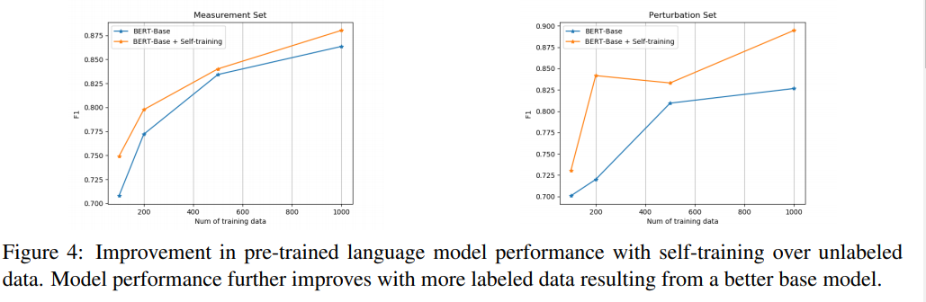
Experiment Results
Notes:
Figure 4 shows the improvement of the BERT teacher model with and without self-training over different test sets. As we increase the number of labeled training instances for training in each setting, the overall performance of both models increase consistently

Slide 18
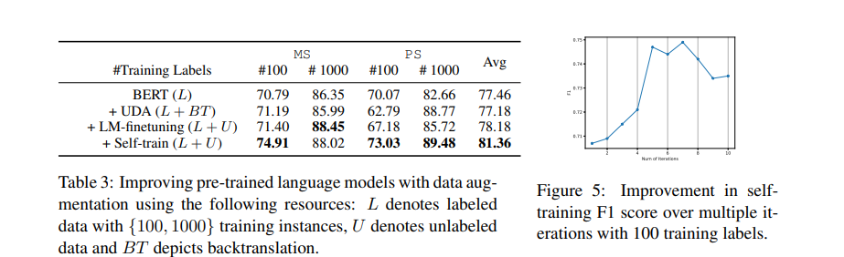
Experiment Results
Notes:
To understand whether model are benefitting from iteratively reusing unlabeled data, Figure 5 shows the improvement in validation F1 score for the BERT model with self-training over multiple iterations with K = 100 labeled instances (plots for other values of K are similar, and omitted for space). We observe the model to improve rapidly in the first few iterations and converge in around ten iteration
Table 3 shows a comparison of different augmentation techniques in different settings with variable access to unlabeled da
Overall We observe task-specific unlabeled data to be very effective in improving the model via both continued pre-training as well as self-training
In general, we observe selftraining to be more effective with access to task-specific unlabeled data in improving the performance of the base encoder by 5% on average. In contrast, consistency learning with backtranslation is effective in settings with no unlabeled data but with access to auxiliary resources like backtranslation.

Slide 19
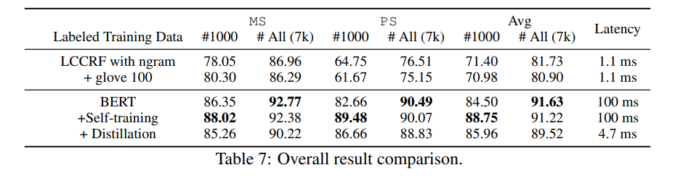
Distillation results
Notes:
In previous section, we study various augmentation techniques to improve pre-trained language models trained with limited data. Given the improved models, the objective now is to compress them to shallow and efficient deployable models for fast inference.
In this, we consider 7K annotated instances to obtain the upper performance bound for our task.
Table 7 shows the performance of different methods including our model in production based on Linear Chain Conditional Random field (LCCRF). LCCRF models are used with n-gram- and lexicon-based features with 100d Glove word embeddings. We observe BERT models to be significantly better than LCCRF, although the deep pre-trained models are 100x times slower for inference.
While performance of all the methods improve on using additional labeled data, we observe self training to further improve the performance of the pre-trained language models for the different test sets.
Furthermore, with distillation we are able to compress the huge language models for 21x faster inference while almost matching their performance on average.
Also Incorporating self-training for augmentation and distillation for compression improve the pre-trained BERT models significantly on the perturbation set demonstrating a high robustness for our model

Slide 20
Q1 plan
MDM
Combine self-training and perturbation-based augmentation
Challenges:
High resource setting
Multi-task training
Trade-off between accuracy and robustness
Robustness measurement in LU
Robust LU Modeling via using Data Augmentation
Notes:
For next quarter, we plan to investigate more in MDM
Given the high baseline in MDM, investigate the robustness of LU model

Slide 21
Appendix

Slide 22
Why self-training works:
Essential guidance based on theories
Regularization in Neural Network are essential in self-training
Label sharpening (soft pesudolabels vs hard pesudolabels)
Hard pesduolabels works better?

Slide 23
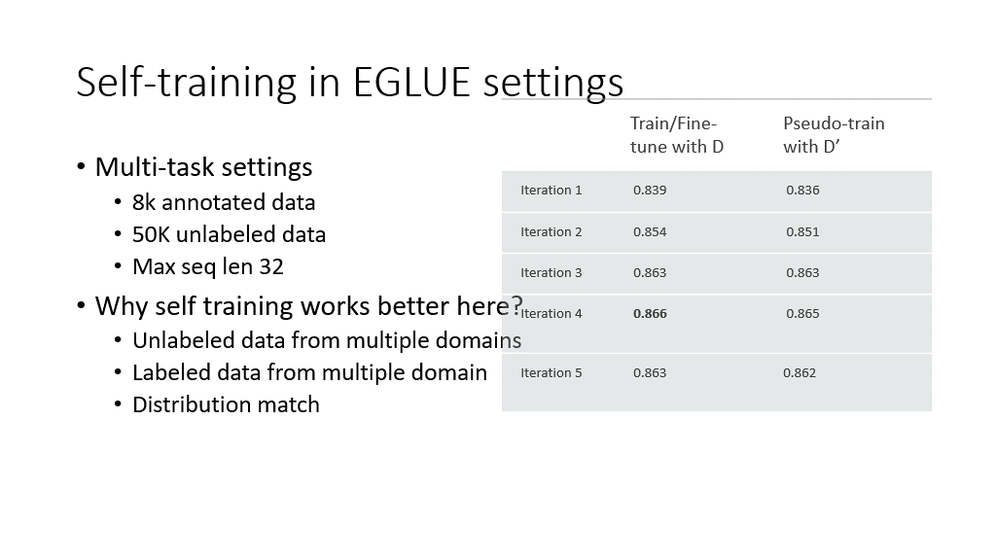
Q & A

